Slide 1
2D game audio
Course : 2D Game Programming
Effective Period : September 2018

Slide 2
These slides have been adapted from: Pereira, V. (2014). Learning Unity 2D Game Development by Example, Packt Publishing, Inc. San Francisco. ISBN: 9781783559046 Chapter 10
Acknowledgement

Slide 3
Learning Objectives
LO 1 : Create 2D game for PC platform
LO 2 : Apply best practices of 2D game development
LO 3 : Design 2D game for PC platform

Slide 4
Audio
To really bring our games to life, we normally need to add audio. Audio includes the following:
Music
Sound effects

Slide 5
Music
Music is not always necessary within a game; however, it can really make a game feel so much more atmospheric and exciting. Pacing the music successfully, one can add relaxing moments, foreboding moments, and tense, action-packed, climactic moments.
It can aid in the storytelling and expressionism or provide a unique form of escapism.

Slide 6
Sound effects
Sound effects add extra depth to a game and can be categorized as follows:
Ambient sound effects: This comprises the surrounding environmental sound effects coming from all around.
GUI sound effects: This comprises interface sound effects, consisting of clicks, button presses, and the like, providing feedback to the player.
Feedback sound effects output: This comprises sound effects based on everything happening within the game, for instance, the character jumping, or when a player loses or wins in a level. All these sounds provide important feedback to the player allowing them to understand what is going on within the game to learn and improve or simply enjoy.

Slide 7
Basic Theory
In real life, sounds are emitted by objects and heard by listeners. The way a sound is perceived depends on a number of factors. A listener can tell roughly which direction a sound is coming from and may also get some sense of its distance from its loudness and quality. A fast-moving sound source (like a falling bomb or a passing police car) will change in pitch as it moves as a result of the Doppler Effect. Also, the surroundings will affect the way sound is reflected, so a voice inside a cave will have an echo but the same voice in the open air will not.

Slide 8
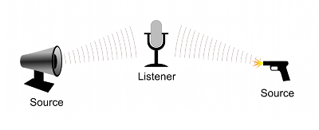
Basic Theory
Audio Sources and Listener
Image source:
http://docs.unity3d.com/Manual/

Slide 9
Basic Theory
To simulate the effects of position, Unity requires sounds to originate from Audio Sources attached to objects. The sounds emitted are then picked up by an Audio Listener attached to another object, most often the main camera. Unity can then simulate the effects of a source’s distance and position from the listener object and play them to the user accordingly. The relative speed of the source and listener objects can also be used to simulate the Doppler Effect for added realism.

Slide 10
Basic Theory
Unity can’t calculate echoes purely from scene geometry but you can simulate them by adding Audio Filters to objects. For example, you could apply the Echo filter to a sound that is supposed to be coming from inside a cave. In situations where objects can move in and out of a place with a strong echo, you can add a Reverb Zone to the scene. For example, your game might involve cars driving through a tunnel. If you place a reverb zone inside the tunnel then the cars’ engine sounds will start to echo as they enter and the echo will die down as they emerge from the other side.

Slide 11
Working with Audio Assets
Unity can import audio files in AIFF, WAV, MP3 and Ogg formats in the same way as other assets, simply by dragging the files into the Project panel. Importing an audio file creates an Audio Clip which can then be dragged to an Audio Source or used from a script. The Audio Clip reference page has more details about the import options available for audio files.
For music, Unity also supports tracker modules, which use short audio samples as “instruments” that are then arranged to play tunes. Tracker modules can be imported from .xm, .mod, .it, and .s3m files but are otherwise used in much the same way as ordinary audio clips.

Slide 12
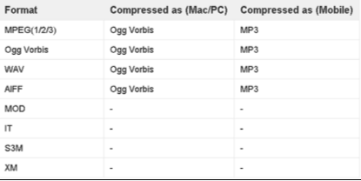
Audio
Supported formats
Image source:
http://docs.unity3d.com/Manual/

Slide 13
Tracker Module
Tracker Modules are essentially just packages of audio samples that have been modeled, arranged and sequenced programatically. The concept was introduced in the 1980’s (mainly in conjunction with the Amiga computer) and has been popular since the early days of game development and demo culture.
Tracker Module files are similar to MIDI files in many ways. The tracks are scores that contain information about when to play the instruments, and at what pitch and volume and from this, the melody and rhythm of the original tune can be recreated. However, MIDI has a disadvantage in that the sounds are dependent on the sound bank available in the audio hardware, so MIDI music can sound different on different computers. In contrast, tracker modules include high quality PCM samples that ensure a similar experience regardless of the audio hardware in use.

Slide 14
Tracker Module
Unity supports the four most common module file formats, namely Impulse Tracker (.it), Scream Tracker (.s3m), Extended Module File Format (.xm), and the original Module File Format (.mod).
Tracker module files differ from mainstream PCM formats (.aif, .wav, .mp3, and .ogg) in that they can be very small without a corresponding loss of sound quality. A single sound sample can be modified in pitch and volume (and can have other effects applied), so it essentially acts as an “instrument” which can play a tune without the overhead of recording the whole tune as a sample. As a result, tracker modules lend themselves to games, where music is required but where a large file download would be a problem.

Slide 15
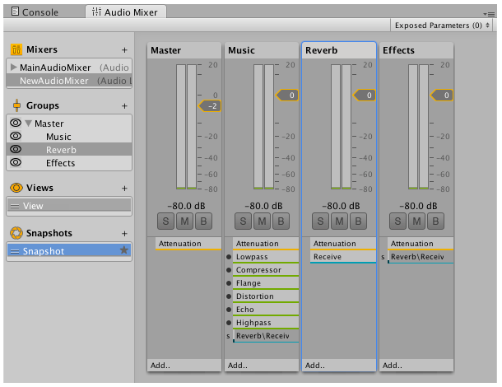
AudioMixer
The Unity Audio Mixer allows you to mix various audio source, apply effects to them, and perform mastering.
The window displays the Audio Mixer which is basically a tree of Audio Mixer Groups. An Audio Mixer group is essentially a mix of audio, a signal chain which allows you to apply volume attenuation and pitch correction; it allows you to insert effects that process the audio signal and change the parameters of the effects. There is also a send and return mechanism to pass the results from one bus to another.
Image source:
http://docs.unity3d.com/Manual/

Slide 16
Audio Profiler
In the Profiler window there is a pane called Audio. The pane monitors significant performance meters about the audio system, such as total load and voice counts. When you highlight the pane, the lower part of the window changes into a detailed view about various parts of the audio system not covered by the graphs.
Playing Sources is the total playing sources in the scene at a specific frame. Monitor this to see if audio is overloaded.
Paused Sources is the total paused sources in the scene at a specific frame.
Audio Voice is the actually number of audio (FMOD channels) voices used. PlayOneShot is using voices not shown in Playing Sources.
Audio Memory is the total RAM used by the audio engine.

Slide 17
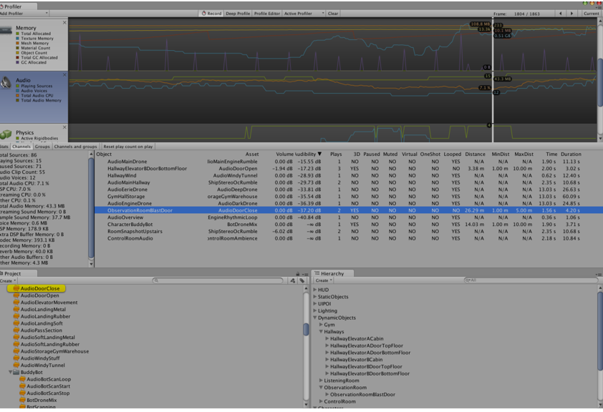
Audio Prodiler
CPU usage can be seen in the bottom. Monitor this to see if Audio alone is taking up too much CPU.
Image source:
http://docs.unity3d.com/Manual/

Slide 18
Adding Audio
Download the audio wave file spin_jump.wav from the following URL: http://soundbible.com/1898-Spin-Jump.html
Drag the audio file into the Audio folder.
If we click on the imported audio asset file, we can select whether it is a 3D sound (sound manipulated to appear as if it is originating within a specific point in 3D space) or not, as well as its compression settings and therefore file size. When creating games for mobile platforms for instance, we need to keep files compressed and small in size. This does have a minimal effect on the audio quality. For a few very short sound effects, native (uncompressed) audio files can be used; they will not need to be decoded during runtime, thereby reducing runtime processing.
We repeat the preceding steps for jingles_NES00.ogg and jingles_NES01. ogg from SFX Jingles at the following URL: http://freeartsprites.com/audio

Slide 19
Discussion
What aspect does audio is important in 2D game?
Can audio be part of the game play?

Slide 20
References
Freeman, J. (2015). Unity’s New 2D Workflow
Vidyasagar. (2014. Unity and C#: Game Loop.CodeProject
Pereira, V. (2014). Learning Unity 2D Game Development by Example. Packt Publishing, Inc. San Francisco. ISBN: 9781783559046
Unity. (2016). Unity Documentation. http://docs.unity3d.com/Manual/

